Slide 1
Team High Ball
Project Proposal
David Richardson
Mathew Manning
Brandon Redder
David Sanchez
Kristine Scott
Kyle Watters

Slide 2
Agenda
Introduction
Design
Updates
Timeline
Next Steps

Slide 3
Introduction
Position controlled high altitude balloon
Helium and ballast release to control altitude
Varying wind currents will direct the balloon
Low cost method for deploying payloads

Slide 4
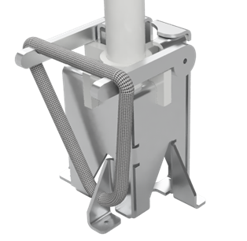
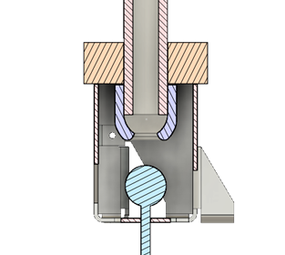
Design
Styrofoam housing
Novel cutdown mechanism
Position control software
Notes:
Kyle
Notes: Too long, remember a few key words and don’t repeat information that is already known. Compare to other possibilities that were discussed.
Styrofoam Housing - Inexpensive with attractive thermal properties and shock absorption for delicate electronics while adding a degree of water resistance to the payload. Lacks structural support, but with close connection between balloon and payload the instantaneous tension on the bracket should be near constant without sharp peaks. Cited downside is tendency to fall over upon landing making SPOT gps unreliable, but external antenna should help prevent this, and the position reports sent while falling combined with flight path simulations should provide accurate landing location.
Novel cutdown mechanism - Traditional latex HABs are separated from the payload by 30-40 feet, but the need to vent helium requires a much closer connection. To limit mechanical complexity nichrome wire is still used instead of a fully mechanical system. To prevent accidental helium release the bracket is designed to limit movement between the connector and the bracket.
Altitude Control Software - Using weather forecasts from the NOAA it is possible to determine likely weather conditions for any given point in the atmosphere with some statistically known error variable. You can then predict the location of the payload at some point in the future based on its current location and ambient weather data. Combining this with altitude control systems allows a computer simulation to determine future position as a result of deliberate changes in altitude to direct the payload to a new location.

Slide 5
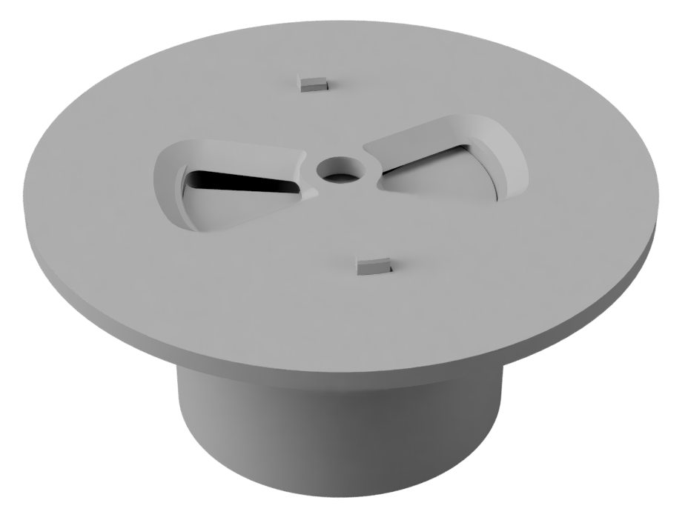
Hardware Updates
PCB - Revision 2 * in progress
Schematic - Revision 3 * Complete
Battery Monitor
Bug Fixes
Fabrication
3D Parts * Complete
Notes:
Brandon

Slide 6
Software Updates
Github with template
Subsystem Outline
Sensor Code * 60% complete
Communication * 30% complete
Simulation * 60% complete
Notes:
Kristy
The software development has been outlined as a state machine which will have four states. These states will determine what systems are running and the frequency of communication with the payload. About 60% of the code for interfacing with sensors is complete. 30% of the communication code and 60% of the wind simulation code.

Slide 7
Timeline
Testing/Documentation Completion Target (Sept. 15)
HW/SW Completion Target (Sept. 22)
Full Ground Test (Sept. 30)
First Launch - Beginning of October (Oct. 6)
Second Launch - TBD
Notes:
David S.

Slide 8
Next Steps - Hardware
Fabrication
Waterjet - currently offline / Partially Functional
Milling Parts
PCB - Finish Design
Electrical Integration
Foam Housing
Model, Cut, and Build
Notes:
Mathew Manning
Waterjetting - AL plate
Milling - Rod for Ballast
Foam - Foam cutter

Slide 9
Next Steps - Software
Control Algorithm
Ground Interface
Finish Code Development
Create Code Test Environment
Notes:
David R.

Slide 10
Questions?
Manning, Mathew W - mathew@gatech.edu
Redder, Brandon A - brandonr@gatech.edu
Richardson, David K - drichardson42@gatech.edu
Sanchez, David - dsanchez36@gatech.edu
Scott, Kristine L - kscott43@gatech.edu
Watters, Kyle C - kwatters6@gatech.edu

